Slide 1
Acceleration for Deep Reinforcement Learning using Parallel and Distributed Computing: A Comprehensive Survey Authors: Zhihong Liu, Xin Xu, Peng Qiao, Dongsheng Li (National University of Defense Technology, China) Course Code: CIT 5203 Course Title: Parallel and Distributed Computing
Presented By
A.B.M. Shifar Emtiuz
ID: 6232020107
Reg: 08417

Slide 2
Introduction
Overview: Deep Reinforcement Learning (DRL) merges deep learning and reinforcement learning, driving AI breakthroughs in gaming, robotics, and healthcare.
Problem: DRL training is computationally intensive due to large neural networks, massive experience data, and complex hyper-parameter tuning.
Solution: Parallel and distributed computing accelerates DRL training.
Survey Goal: Provide a comprehensive review of state-of-the-art acceleration methods, including taxonomy and open-source platforms.

Slide 3
Motivation
Why Accelerate DRL(Deep Reinforcement Learning ):
1
Example: Training DQN on Atari takes 38 days with 50M frames.
Growing complexity demands faster training for real-world applications.
Contribution
First survey to systematically classify DRL acceleration techniques using parallel and distributed computing.
2
Scope
Covers architectures, parallelism strategies, synchronization, evolutionary methods, and libraries.
3

Slide 4
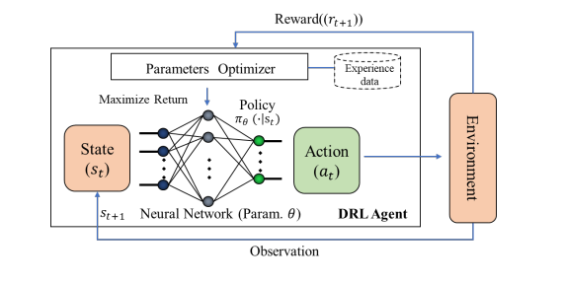
DRL (Deep Reinforcement Learning) Fundamentals
Definition: DRL involves agents learning optimal policies through environment interactions, collecting experience data (state, action, next state, reward).
Key Features:
Handles high-dimensional state spaces.
Self-learns without labeled data.
Enables offline training for online problems.

Slide 5
DRL Classification
Model-Based DRL:
Uses known or learned environment dynamics (e.g., MB-MPO, AlphaZero).
Model-Free DRL:
Value-based (e.g., DQN), policy-based, or actor-critic (e.g., PPO, SAC).
On-Policy vs. Off-Policy:
On-policy: Stable, less sample-efficient.
Off-policy: Sample-efficient, less stable.

Slide 6
Challenges in DRL Training
System Coordination: Managing actors, learners, and parameter servers.
Sample Generation: Producing billions of experience samples (e.g., 2.5B frames for navigation).
Workload Heterogeneity: Frequent data movement across devices.
Synchronization Issues: Obsolete gradients in heterogeneous environments.
Optimization Limits: Stochastic gradient descent prone to local optima.

Slide 7
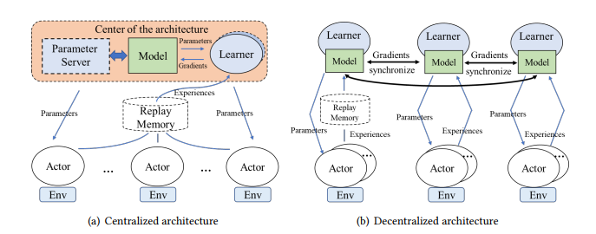
System Architectures Overview
Components:
Actors: Environment interaction.
Learners: Gradient computation.
Parameter Servers: Model maintenance.
Replay Memory: Off-policy data storage.
Architecture Types: Centralized (star topology) vs. Decentralized (fully connected).

Slide 8
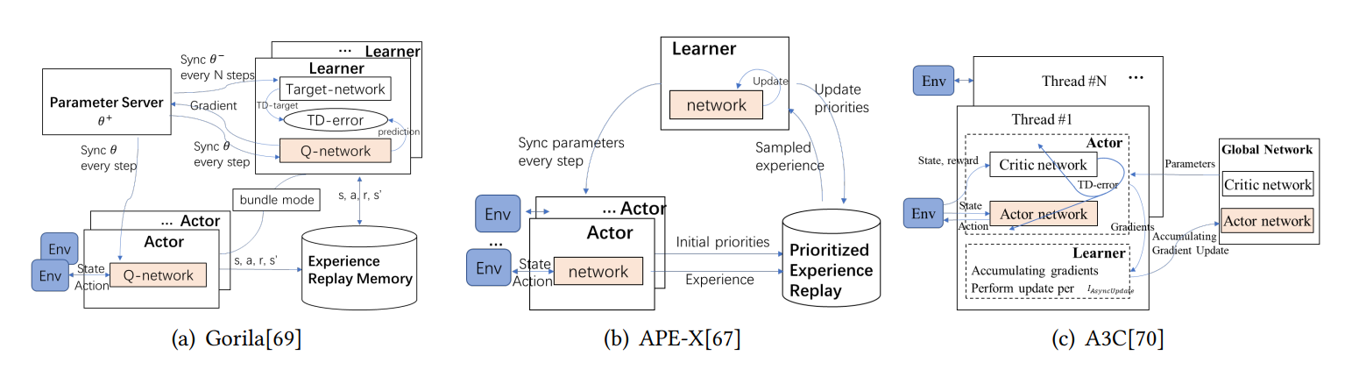
Centralized Architectures
Features: Central node maintains global model, simpler synchronization but scalability bottleneck.
Examples:
Gorila: Massively distributed DQN, 10x faster training.
APE-X: Prioritized experience replay for DQN.
A3C: On-policy learning with actor-learner threads.

Slide 9
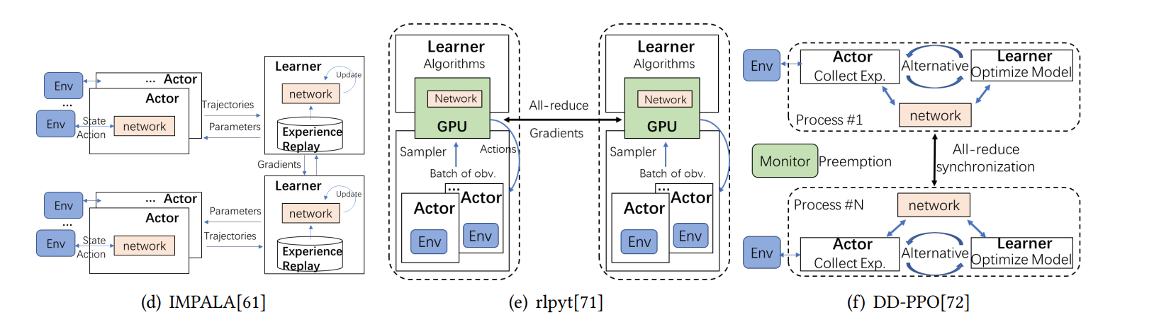
Decentralized Architectures
Features: Multiple learners aggregate gradients via all-reduce, scalable but with synchronization overhead.
Examples:
IMPALA: CPU actors, GPU learners, synchronous updates.
rlpyt: Multi-GPU acceleration with all-reduce.
DD-PPO: Scalable across machines, combined actor-learner.

Slide 10
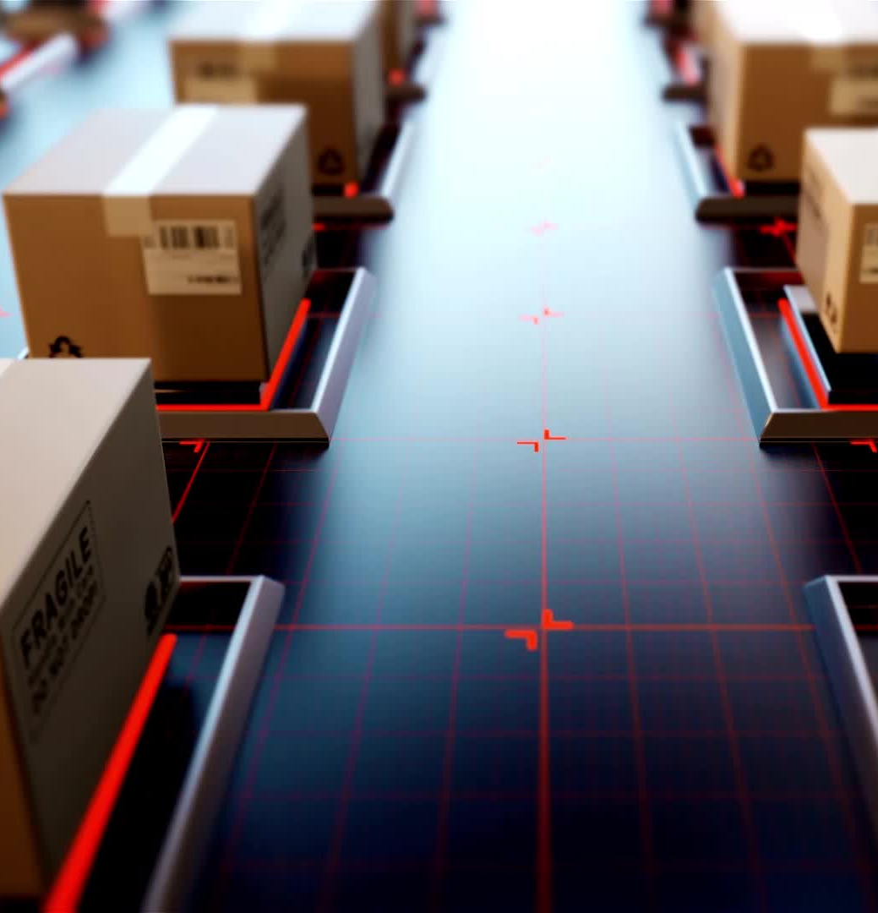
Simulation Parallelism
Role: Simulations (e.g., OpenAI Gym, MuJoCo) generate training samples.
Challenges: High computational cost for physics and rendering.
Solutions:
Parallel simulation environments.
GPU-accelerated simulations for robotics.
Large-batch simulations for efficiency.
Platforms: OpenAI Gym, MuJoCo, Unity ML, Gazebo, AirSim, Brax.

Slide 11
Computing Parallelism
Data Parallelism: Splits data across workers with model replicas.
Model Parallelism: Divides neural network for large models.
Pipeline Parallelism: Processes model layers in stages.
Hybrid Approaches: Combines schemes (e.g., ZeRo, HeiPipe).
Hardware Support: GPUs for learners, CPUs for actors, FPGAs for tasks.

Slide 12
Distributed Synchronization
Goal: Synchronize backpropagation-based training.
Methods:
Synchronous: Stable but slower (e.g., IMPALA).
Asynchronous: Faster but less stable (e.g., A3C, APE-X).
Prioritized Experience Replay: Focuses on high-error samples.
Innovation: Gossip-based peer-to-peer synchronization.

Slide 13
Deep Evolutionary Reinforcement Learning
Approach: Evolution-based training avoids local optima.
Techniques:
Evolution Strategies: Scalable RL alternative.
Neural Architecture Search: Evolves network topologies.
Population-Based Training: Enhances policy diversity.
Pros: Robust, scalable. Cons: Computationally expensive.

Slide 14
Advanced Parallelism Techniques
Pipeline Parallelism:
Splits model layers into stages for pipelined processing.
Example: HeiPipe for DRL with layered neural networks.
Hybrid Parallelism:
Combines data, model, and pipeline parallelism.
Example: ZeRo optimizes memory and computation.
DRL Adaptation: Handles dynamic workloads from environment interactions.

Slide 15
Hardware Acceleration for Parallelism
Hardware Roles:
GPUs: Accelerate learner gradient computations.
CPUs: Handle actor environment interactions.
FPGAs: Optimize specific tasks (e.g., FA3C, QtAccel) .
Benefits: Reduces training time (e.g., GPU-based simulations in robotics).
Challenges: Hardware heterogeneity requires tailored frameworks.

Slide 16
Distributed Synchronization
Goal: Synchronize backpropagation-based training across workers.
Methods:
Synchronous: Stable, slower (e.g., IMPALA).
Asynchronous: Faster, less stable (e.g., A3C, APE-X).
Prioritized Experience Replay: Focuses on high-error samples.
Innovation: Gossip-based synchronization for peer-to-peer scalability.

Slide 17
Open-Source Platforms
Overview: 16 libraries compared for DRL development.
Key Examples:
Ray RLlib: Scalable RL framework.
SampleFactory: Fine-grained worker optimization.
Fiber: Supports population-based methods.
Evaluation: Usability, scalability, algorithm support, hardware compatibility.

Slide 18
Future Research Directions
Fine-Grained Workers: Task-specific roles (e.g., Actor, Policy, Trainer).
Gossip-Based Architectures: Scalable peer-to-peer communication.
LLM Integration: Enhancing RL with language model feedback.
Gaps:
Balancing actor-learner inference.
Scalable simulations.
Hybrid optimization (backpropagation + evolution).

Slide 19
Case Studies in Parallel DRL
IMPALA: Scales to thousands of CPU cores for fast sample generation .
APE-X: Achieves high throughput with prioritized replay .
DD-PPO: Distributed PPO for multi-machine scalability .
Impact: Reduces training time from days to hours for complex tasks.

Slide 20

Conclusion
Summary
DRL acceleration leverages architectures, parallelism, synchronization, and evolutionary methods.
1
Impact
Enables faster training for robotics, autonomous driving, and more.
2
Contribution:
Comprehensive survey with taxonomy and future directions.
3
Closing
Distributed DRL innovation will drive AI advancements.
4

Slide 21
References
Liu, Z., Xu, X., Qiao, P., & Li, D. (2023). Acceleration for Deep Reinforcement Learning using Parallel and Distributed Computing: A Comprehensive Survey. ACM Computing Surveys, November 2023

